Slide 1
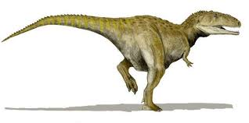
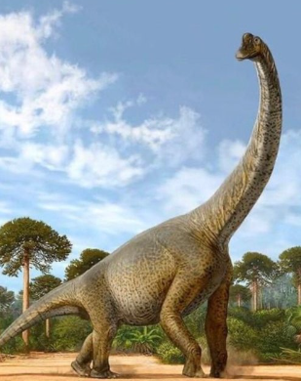
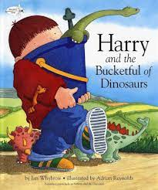
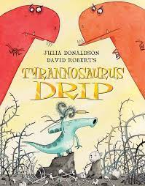
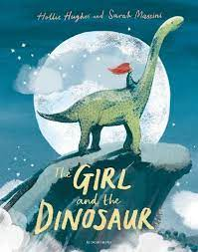
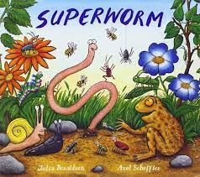
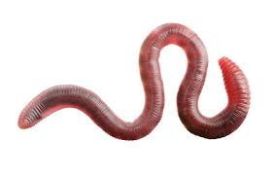
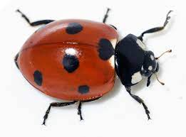
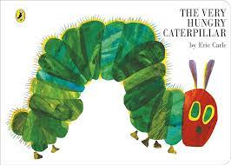
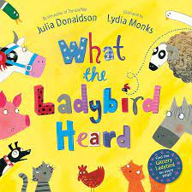
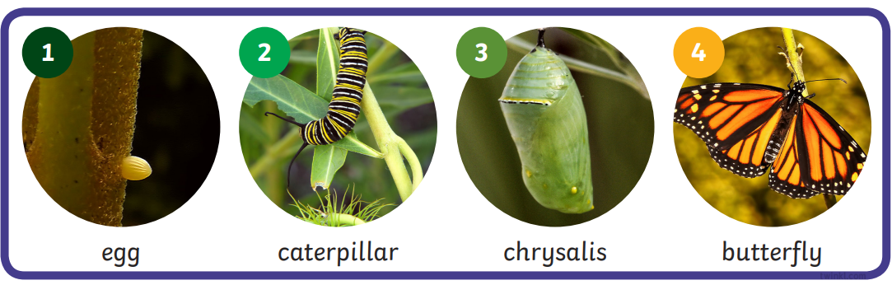
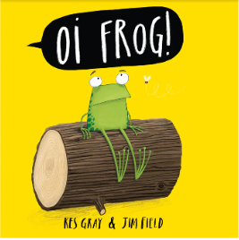
We will be learning…
Key knowledge…
I know..
that herbivores eat plants.
carnivores eat meat.
how to use the words similar and different correctly.
the lifecycle of a butterfly.
that a worm has a saddle, ladybirds have antennae and an insect’s body has 3 main parts, the head, thorax and abdomen.
that all animals are living creatures and should be respected and treated with care.
that animals have life cycles.
that there are a wide variety of animals with different appearances, movements, behaviours and habitats.
that some animals are carnivores and some are herbivores.
that some animals lived in the past and some live in the present.
Questions to share at home…
Animals big
and small
Key Vocabulary…
Minibeast | any small creature such as an insect or a spider
Life cycle | the different stages of life a living thing goes through
Cocoon | the hard structure formed to keep a caterpillar safe
Minute | something that is very, very small
Gigantic | something that is very, very big
Dinosaur | a group of reptiles that lived 250 million years ago
Extinct | no longer in existence
Predator | an animal that naturally preys on others
Herbivore | plant eating animal
Carnivore | meat eating animal
Amphibian | a group of animals that can live in water and on land
What is a herbivore?
What is a carnivore?
What is similar and different about animals from the past and animals in the present?
Tell me about how caterpillars become butterflies?
Which animals can live on land and in water?

